Slide 1
UE19CS390B –Project Phase – 2
Project Progress Review #3
Project Title : Automated Shopping Cart
Project ID : Team 75
Project Guide : Dr. Prajwala T R
Project Team :
S V S C Santosh PES2UG19CS346
Kuntal Gorai PES2UG19CS198
Skanda S PES2UG19CS391
Vijay Murugan A S PES2UG19CS454

Slide 2
Outline
Abstract and Scope of the Project
Suggestions from Review – 2
Implementation Details
Project Demonstration
Results and Discussion
Project Report Draft
Conclusion and Future Work
References

Slide 3
Abstract and Scope
Shopping malls have become an integral part of city life
Everyone is forced to stand in long queues to get the items billed.
Every customer takes a variable amount of time to get their items billed, causing huge queues.
Retail stores rely on cashiers or self-service checkout systems to process the customers’ purchases. Since most products have barcodes that can be scanned, the checkout time has already been minimized.
However, fruits and vegetables are commonly processed differently. The cashier or the customer needs to manually identify the class of product being bought and look for it in the system.
Our product aims to cut down all the hassle faced when a user shops for groceries.

Slide 4
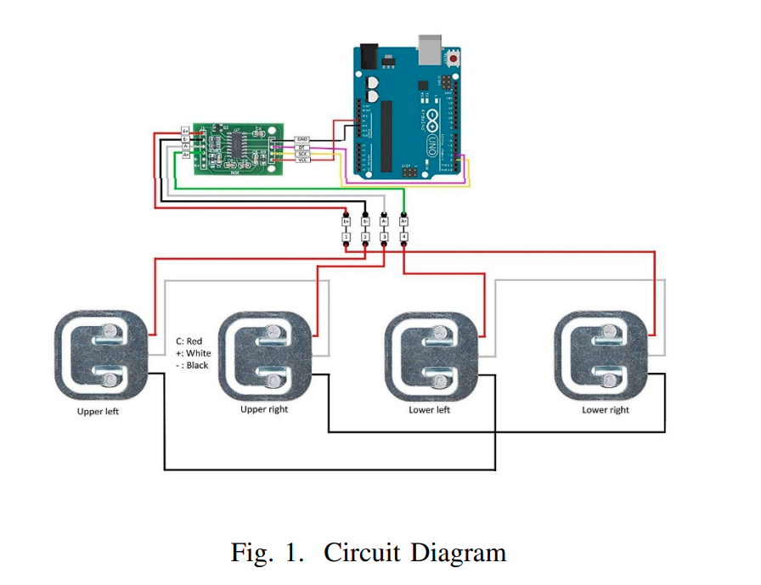
Suggestions from Review - 2
Design of the load cell

Slide 5
Implementation Details
Dataset Building:
A lot of automation has gone into scraping the images from the web and collecting various classes of images from several data sources. The scraped images were later augmented to have a good number of images. We ended up having over 3000 training images and 51 classes resulting in over 153,000 images and built the final dataset.

Slide 6
Implementation Details
Model Development:
We make use of the dataset formed containing 153k images of more than 50 classes which is thereby used to predict the class of the image it belongs to.
Various pre-trained Deep Learning Models, namely Efficient NETV2, MobileNetV2, NasNet with transfer learning and data augmentation were used to create an ensemble model that offers a high accuracy of classification.

Slide 7
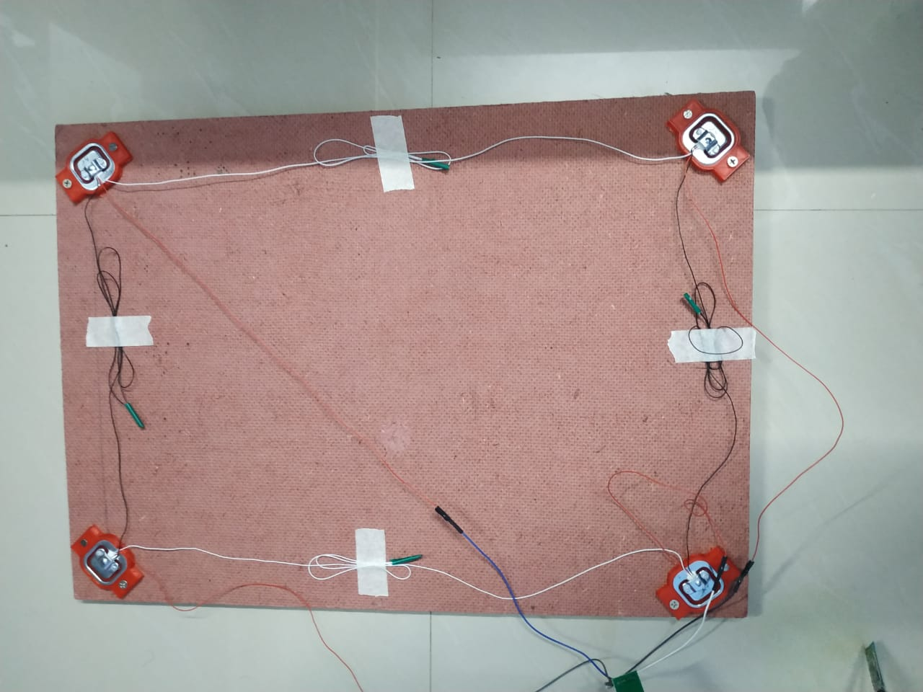
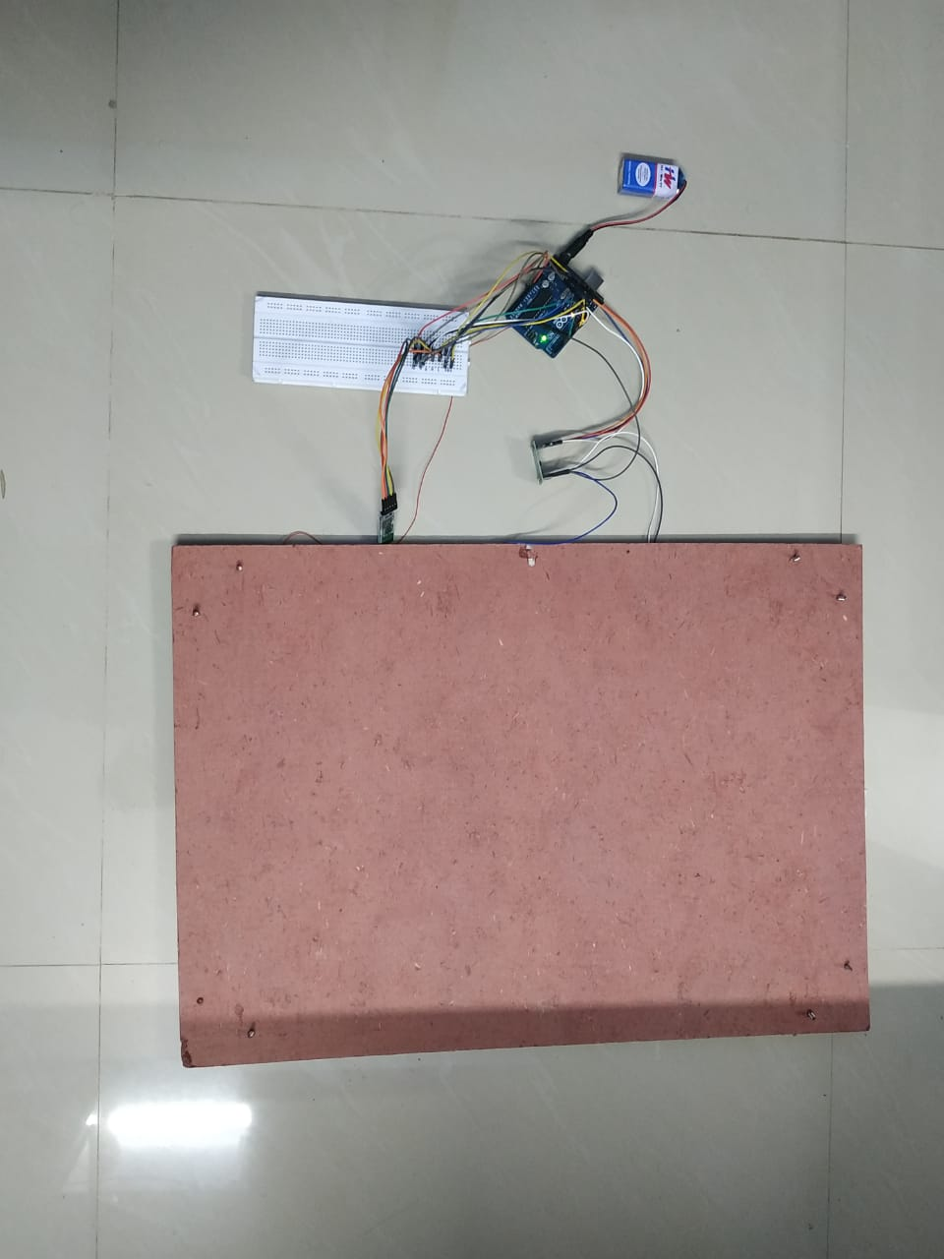
Implementation Details
IoT :
This design has 4 load cells each mounted in a corner with the help of 3D printed mounts connected to a Hx711 amplifier to convert the analog signals to digital signals sent to the Arduino UNO.
Connection to the android app is established via the HC05. Bluetooth module and signals are sent to our android app via the microcontroller.

Slide 8
Implementation Details
App Development
This Module talks about how various pages of an app (each page having a class with attributes and methods) are linked to form a workable system as a whole.
login/register
scan activity
cart items
profile page
orders
previous orders
creation, setup, and of connection firebasebase

Slide 9
Implementation Details
Assumptions
The user will connect to a cart as soon as he enters the mart.
The user takes at least 35 seconds to add a new item to the cart.
The user adds/removes only a single item at a time.

Slide 10
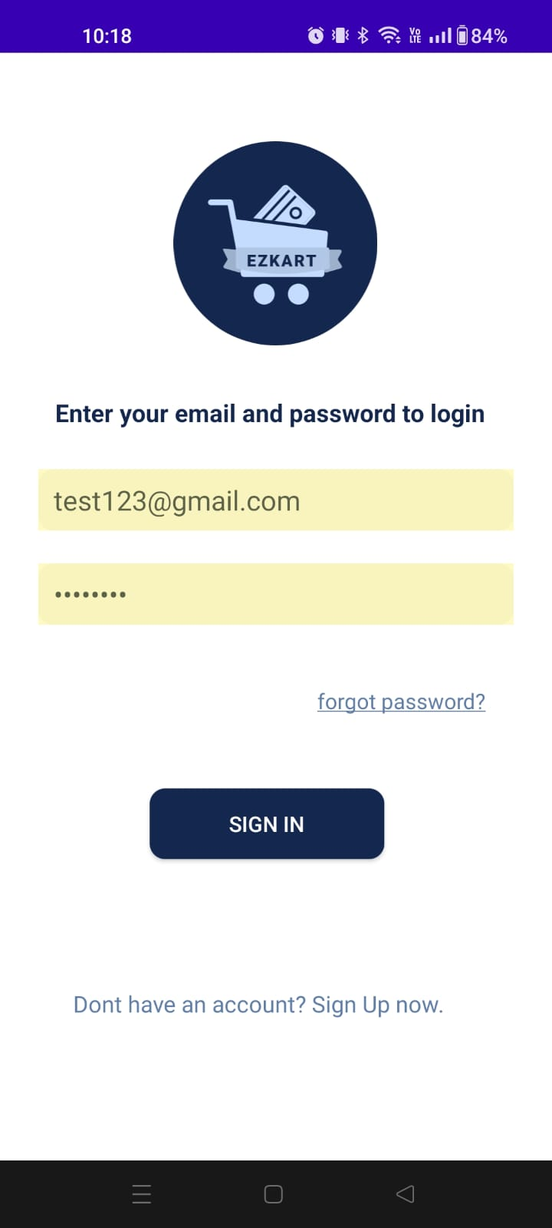
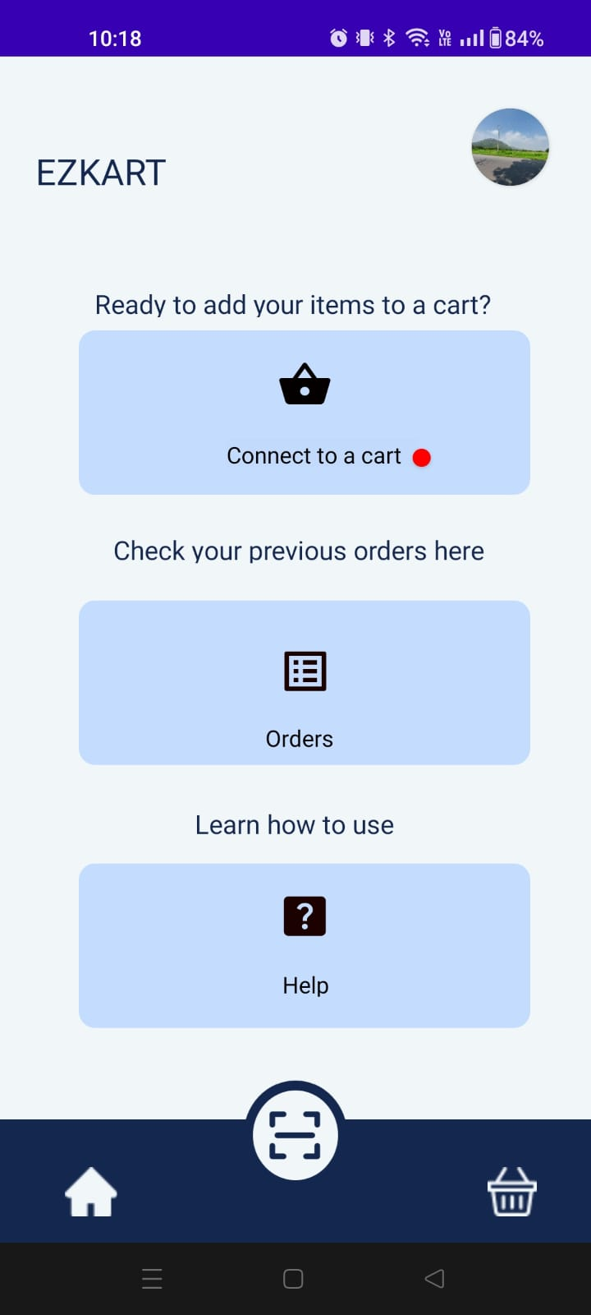
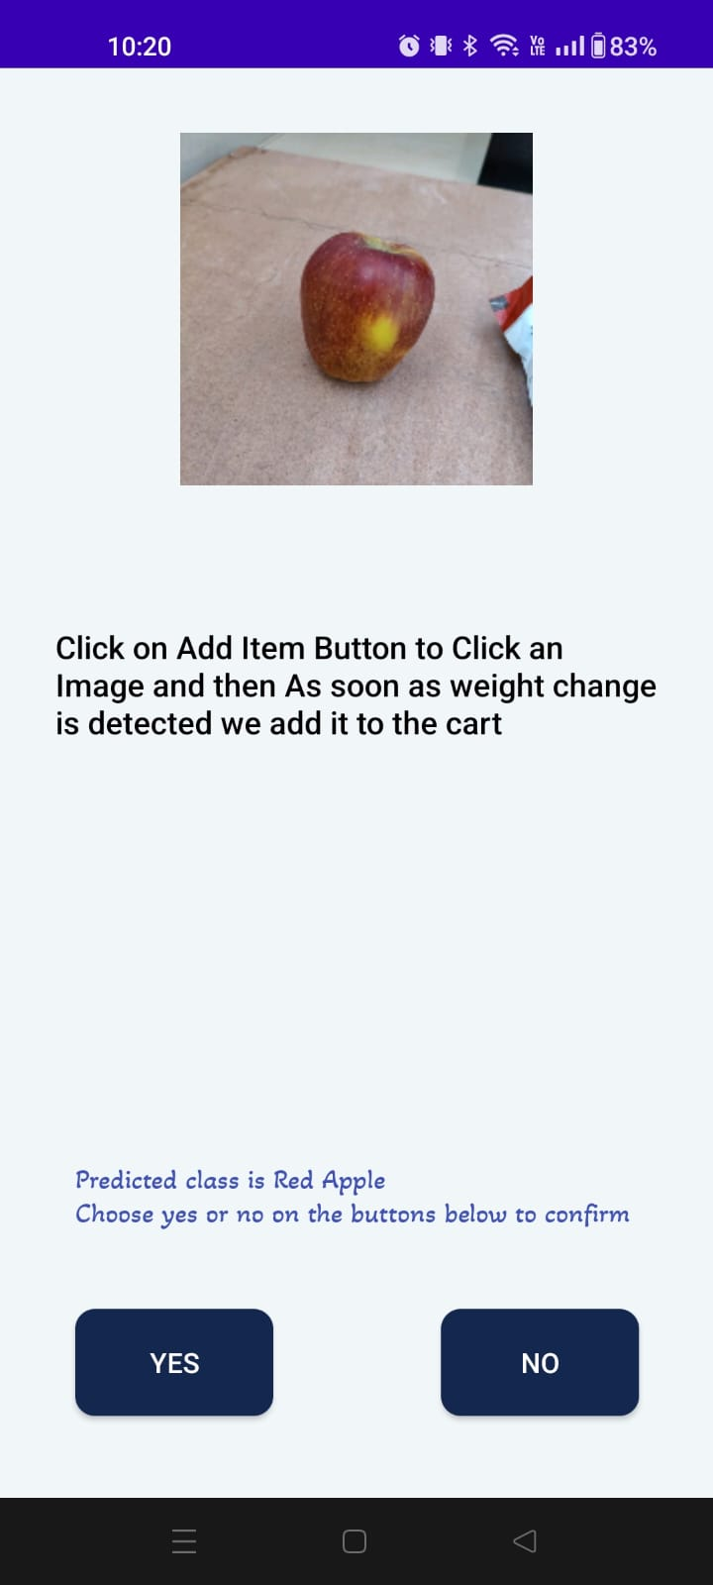
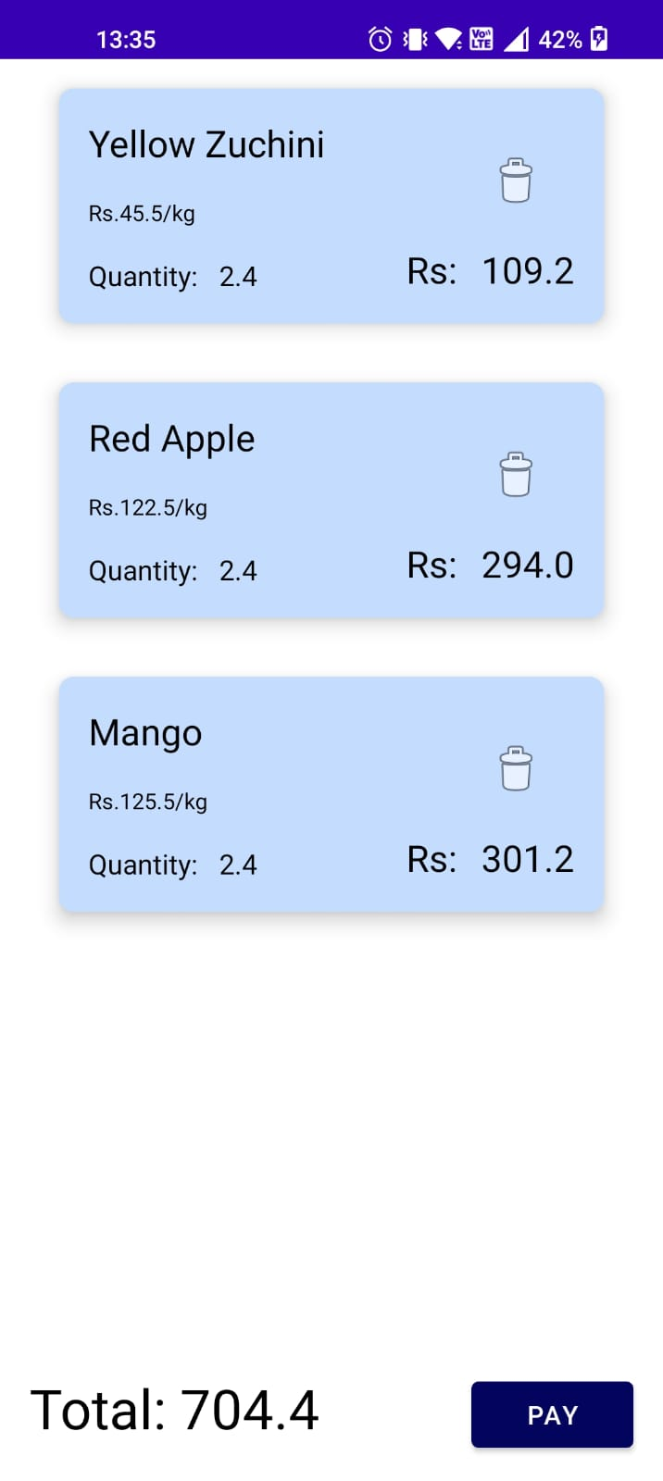
Project Demonstration

Slide 11
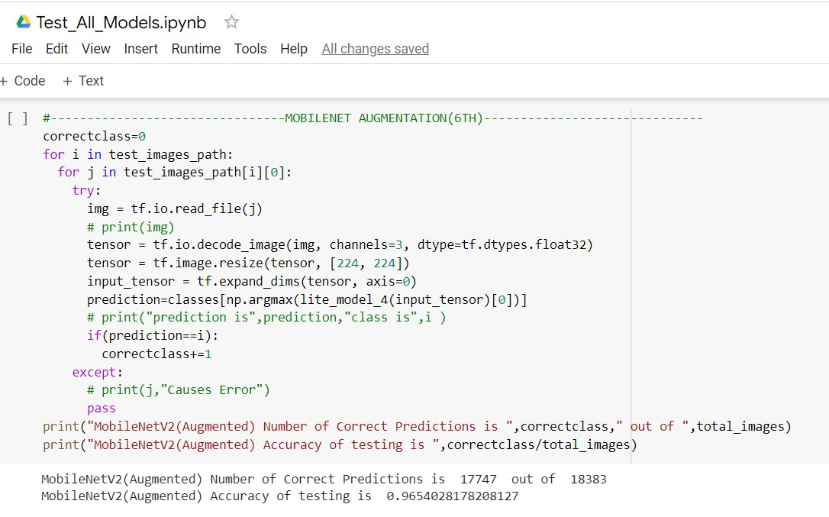
Results and Discussion
96% Accuracy achieved on random test data for mobilenetv2 with augmentation model.

Slide 12
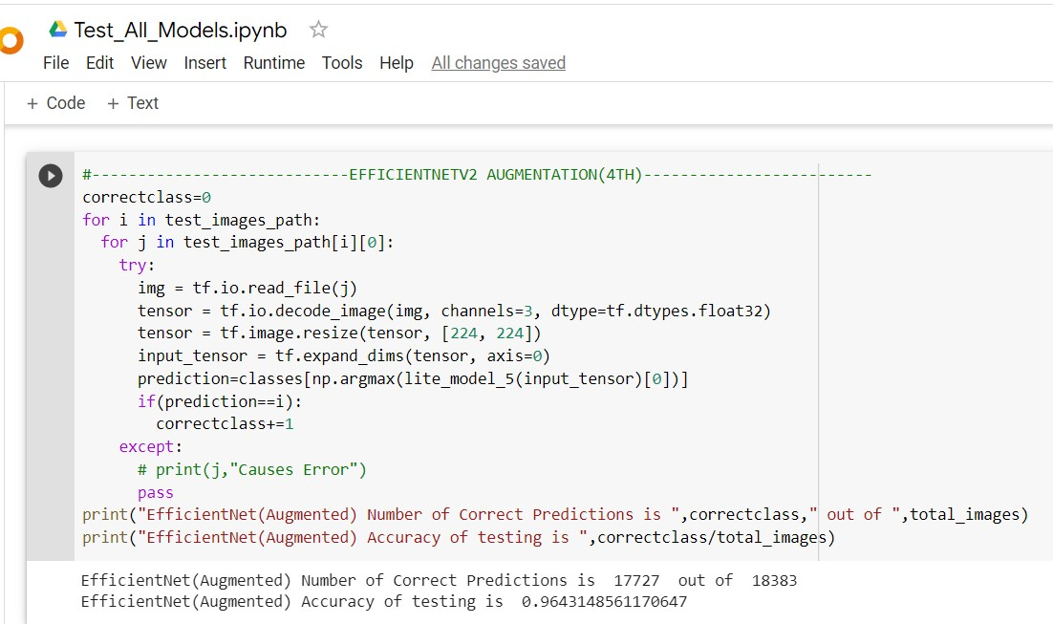
Results and Discussion
96% Accuracy achieved on random test data for efficentnet with augmentation model.

Slide 13
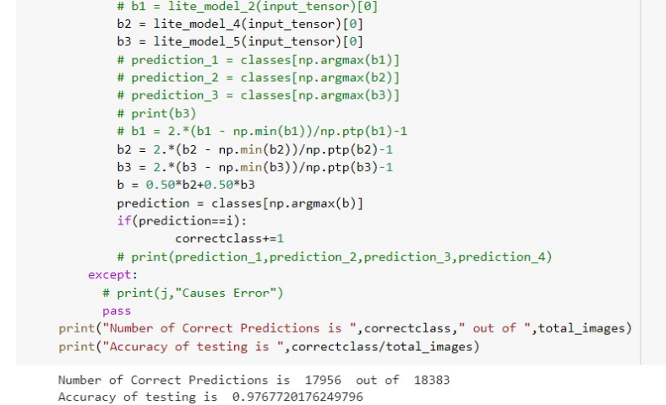
Results and Discussion
98% Accuracy achieved on random test data for ensemble of top 2 accurate models.

Slide 14
Timeline – Update on Tasks
The dataset has been completed
The models have been trained
The database has been set up
IoT components have been built
The app is nearing completion

Slide 15
Conclusion and Future work
The conclusions of the Capstone Project Phase – 2 are the following:
Low level design Document Completed
Building our own custom dataset with the help of web scraping and augmentation.
Training the pre trained model for the custom dataset created.
Implementation of iot components connection with app.
Implementation of pages of the app discussed in low level design completed.
Testing of the app with various scenarios.

Slide 16
Conclusion and Future work
Future work that needs to be done are
Improvements over classifying the certain items that were not able to classify properly.
Updating from typing the cart name to connect to the bluetooth to a QR code for connection.
Customizing the dataset beyond fruits and vegetables with various items present in the shopping cart.
Writing the research paper on the work that has been done by now and publishing to various conferences.

Slide 17
References
M. Klasson, C. Zhang, H. Kjellstrom, ”A Hierarchical Grocery Store Image Dataset with Visual and Semantic Labels” Arxiv, January 2020.
A. Zaina, D. Syed,” Deployment of Deep Learning Models on Resource Deficient Devices for Object Detection ”,Department of Electrical Computer Engineering Texas AM University College Station, Texas, U.S.A., IEEE, May 2020.
JL. Rojas-Aranda, JI. Nunez-Varela,”Fruit Classification for Retail Stores Using Deep Learning ”, Springer, June 2020
SB. Dubey, GM. Kadam, O. Angane,” Android Application for Grocery Ordering System”, Irjet, April 2021
K. Riyanti, I. Kakaravada, A.Ahmed, ” An Automatic Load Detector Design to Determine the Strength of Pedestrian Bridges Using Load Cell Sensor Based on Arduino ”, IJEEEMI, February 2022

Slide 18
Thank You

Slide 19
